Slide 1

Income Inequality and Socioeconomic Indicators Worldwide
Presented by Shivansh Raghav

Slide 2
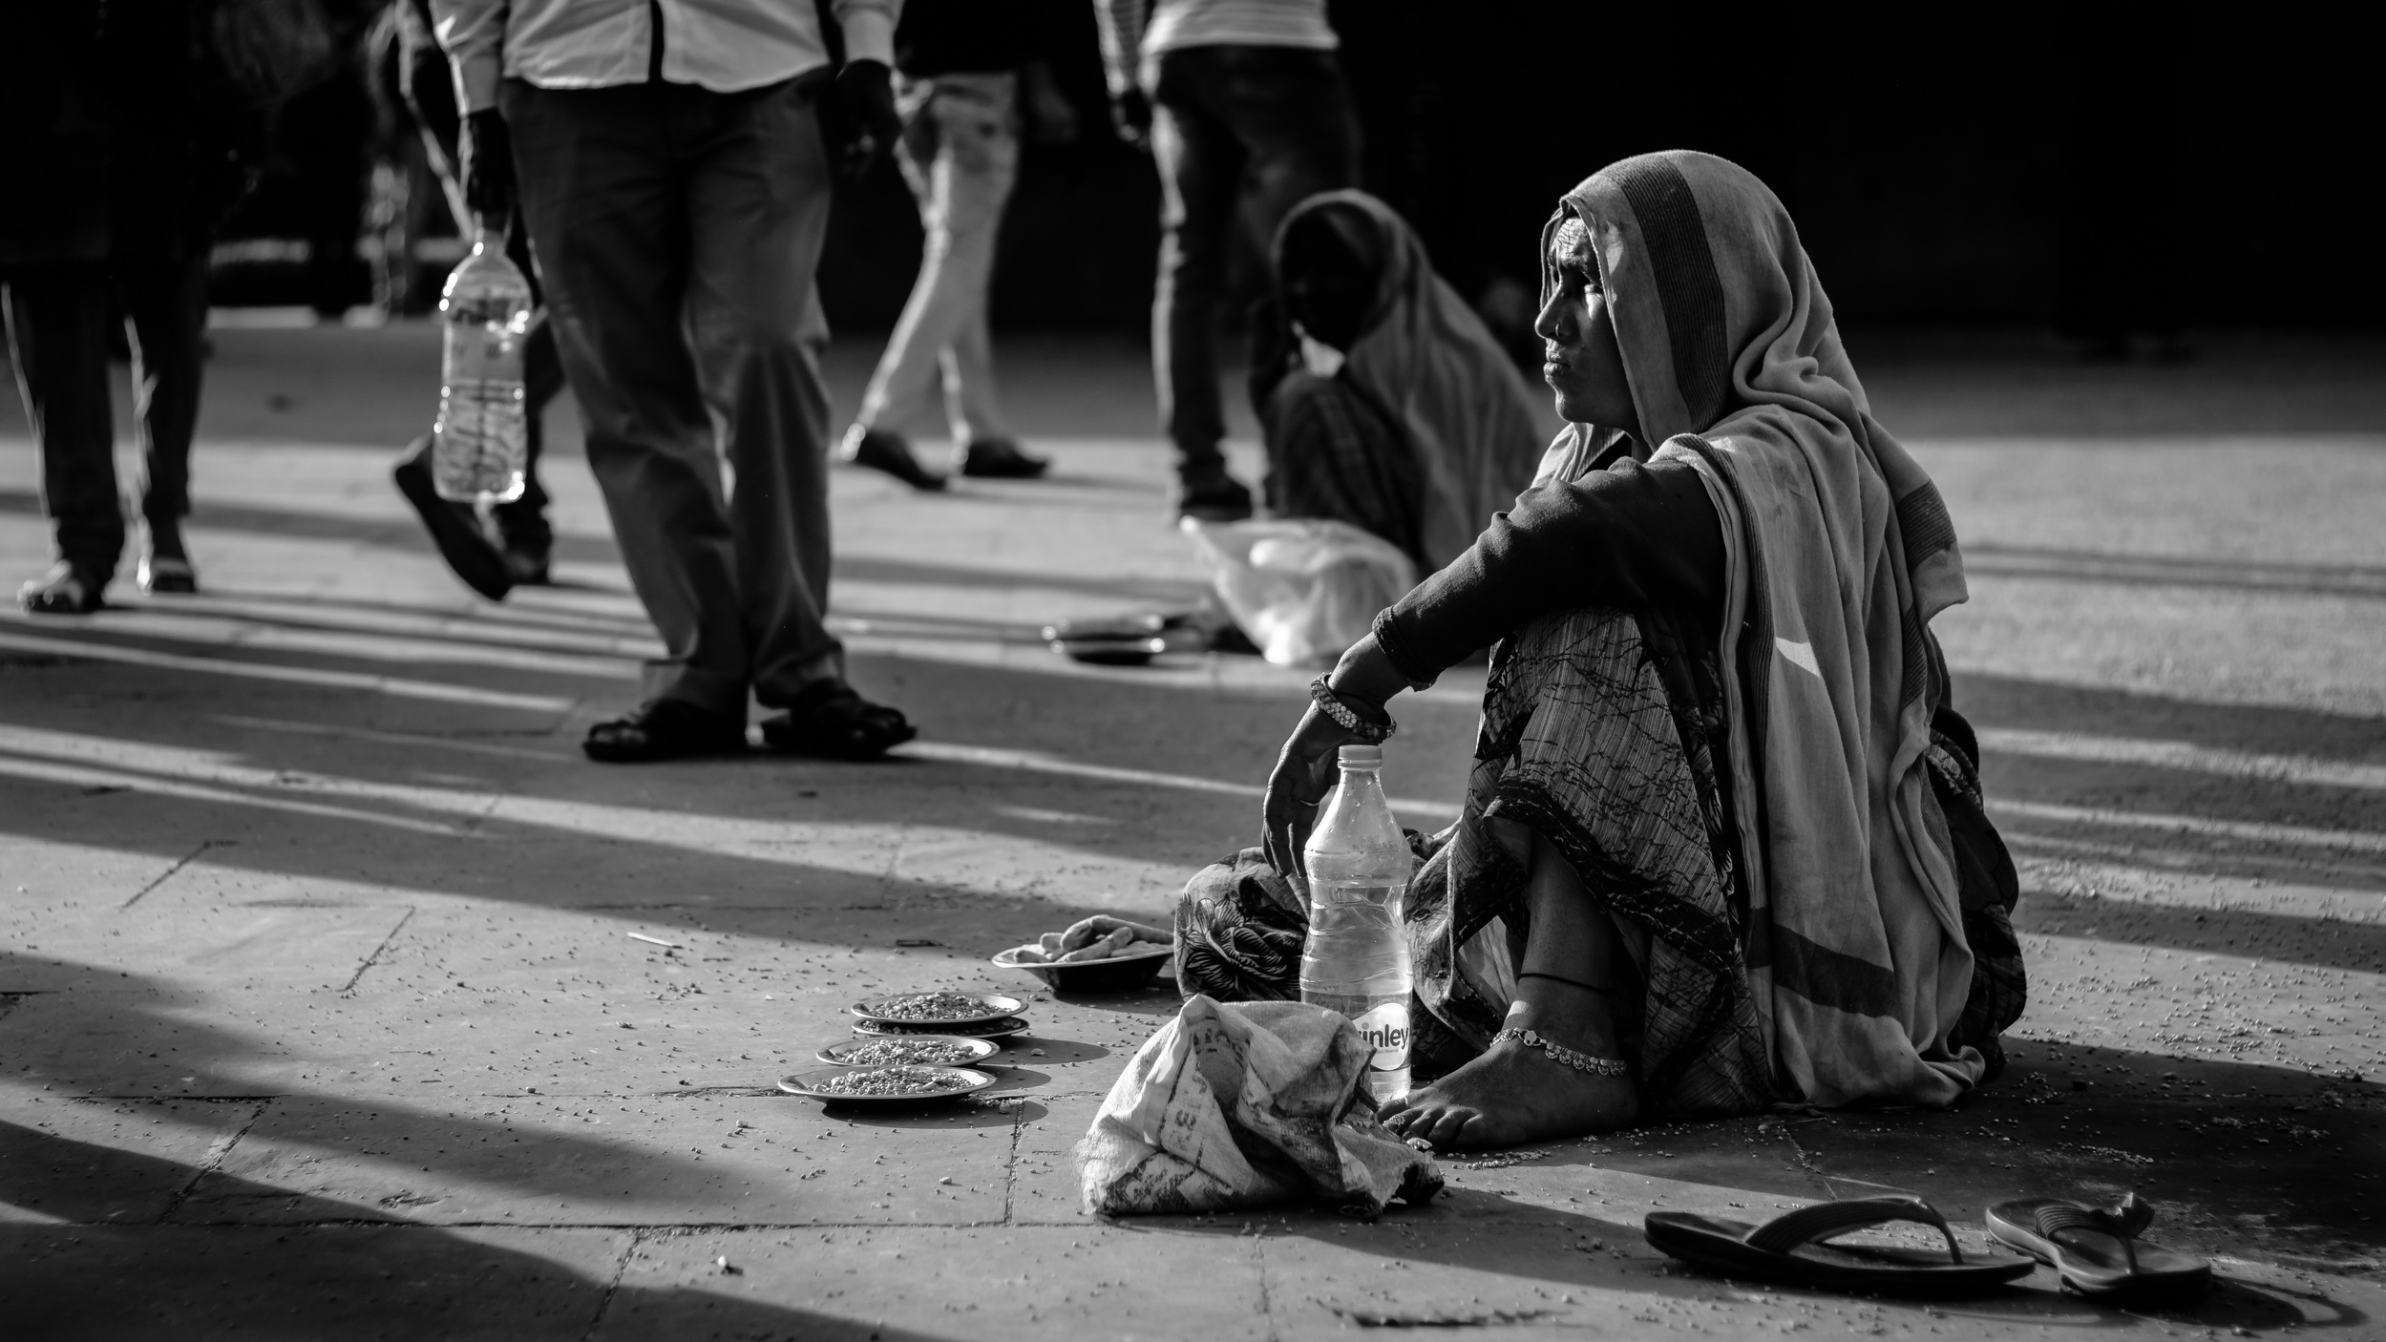

Project Introduction
"Income Inequality and Socioeconomic Indicators Worldwide" is an analysis exploring the relationship between income inequality and key socioeconomic metrics across countries. Using Python's Pandas for data manipulation and Flourish for visualization, the project aims to uncover insights into global disparities and their interaction for human development.

Slide 3





Dataset
Relevance
Potential Insights
The dataset utilized in this analysis comprises income inequality metrics, mean years of schooling, GNI per capita, and life expectancy data for multiple countries. It offers a comprehensive view of global socioeconomic indicators.
Understanding income inequality and its connection to socioeconomic factors is essential for policymakers, researchers, and organizations striving for fair development. By analyzing this dataset, we aim to grasp the concepts of income inequality and various socioeconomic indicators, identify trends, discrepancies, and provide a foundation for potential interventions to support inclusive growth and human welfare.
Through this analysis, we aim to identify:
The extent of income inequality across different regions and countries.
Uncover trends in other socioeconomic metrics across regions and countries.
Relationships between income inequality and indicators such as education, economic performance, and health.
Potential drivers or determinants of income inequality.

Slide 4

01
02
03
DATA PREPARATION
VIZUALISATION
PRESENTATION
Data merging from various sources,data cleaning and manipulation with pandas library using python environment of kaggle notebooks
Importing data into flourish for visualization of key trends and patterns, and publishing to Canva
Creating a presentation in Canva with a voice over to explain the visualizations and key insights

Slide 5
IMPORTANT POINTS
Inequality in Income is measured by the Gini coefficient where 0 represents perfect equality and 100 represents perfect inequality.
Quartiles are created on the basis of the of Income inequality coefficient
Income inequality data where year is not specified pertains to 2021.

Slide 6
A look at Income Inequality

Slide 7
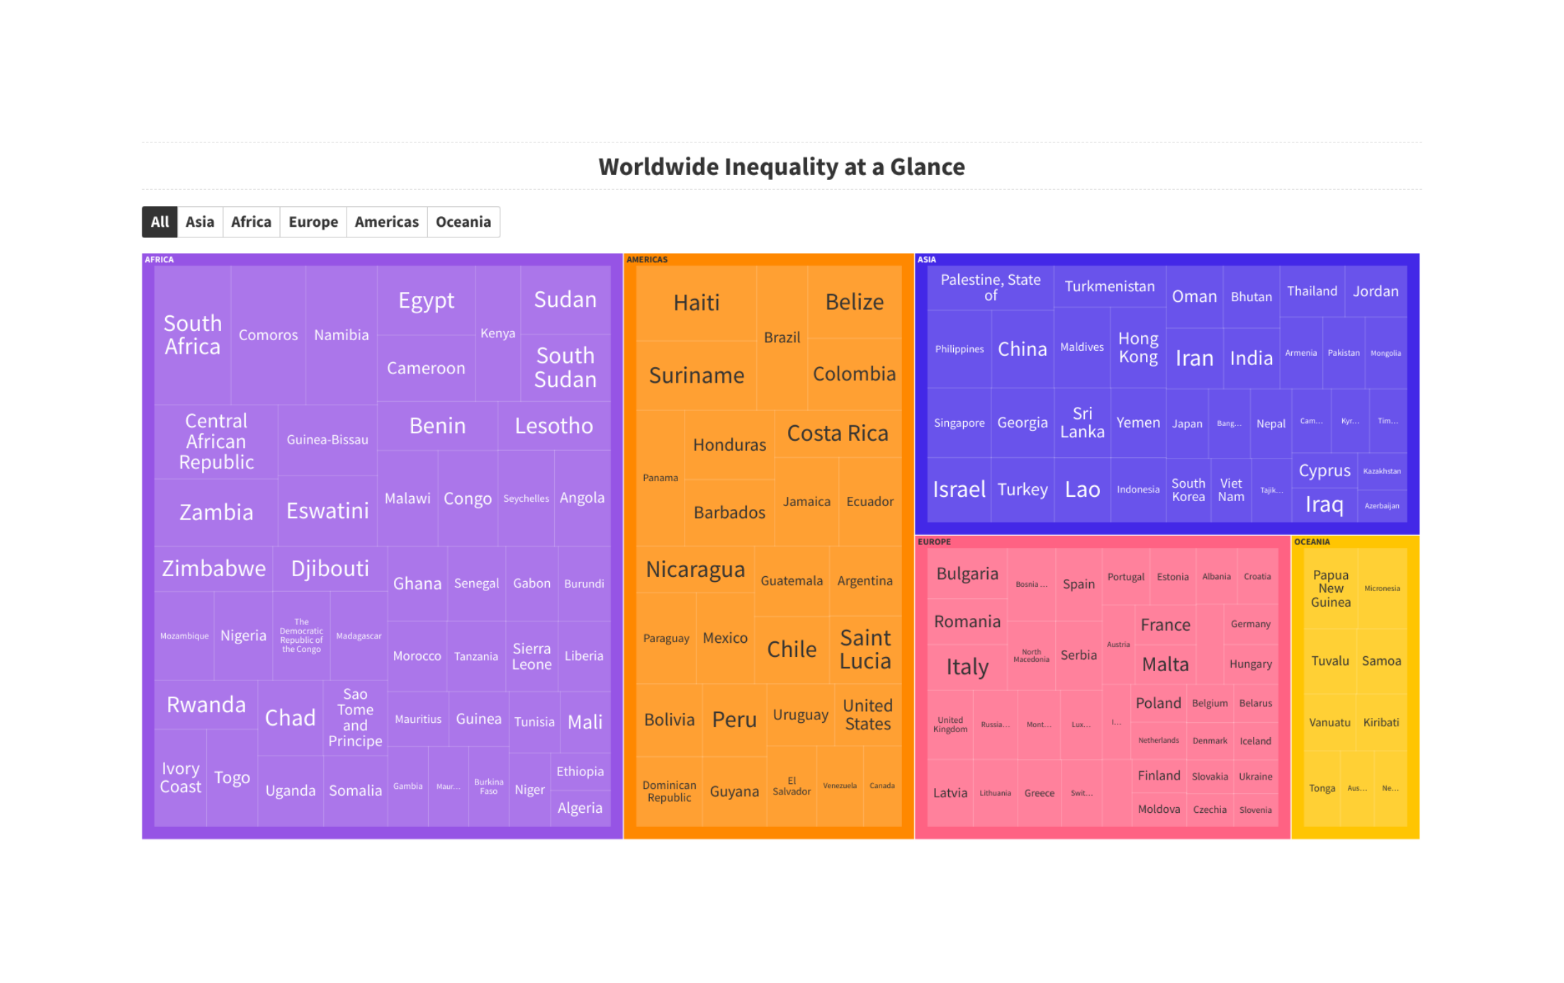

Slide 8
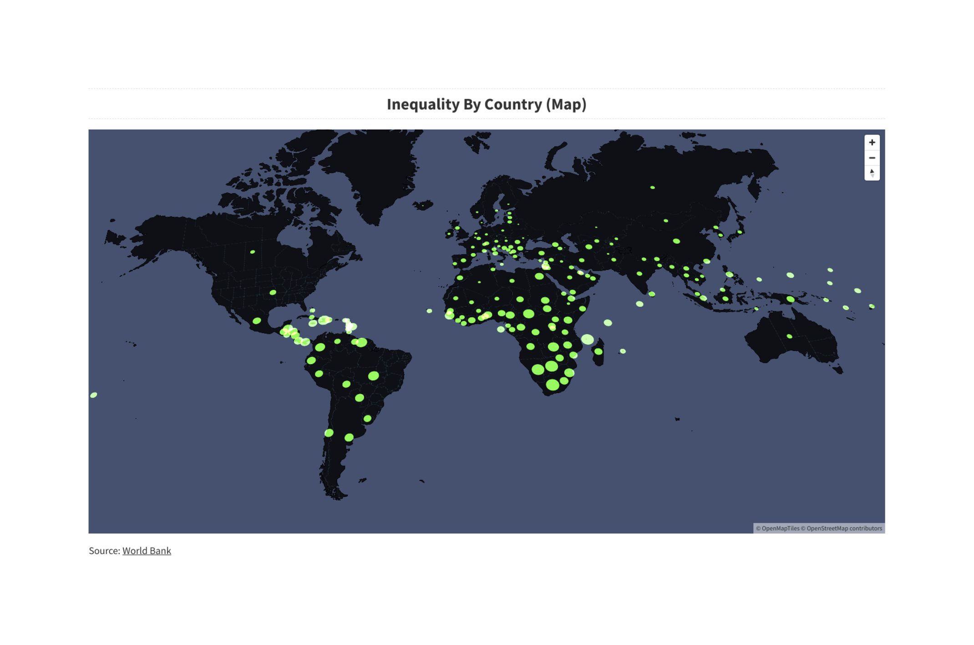

Slide 9
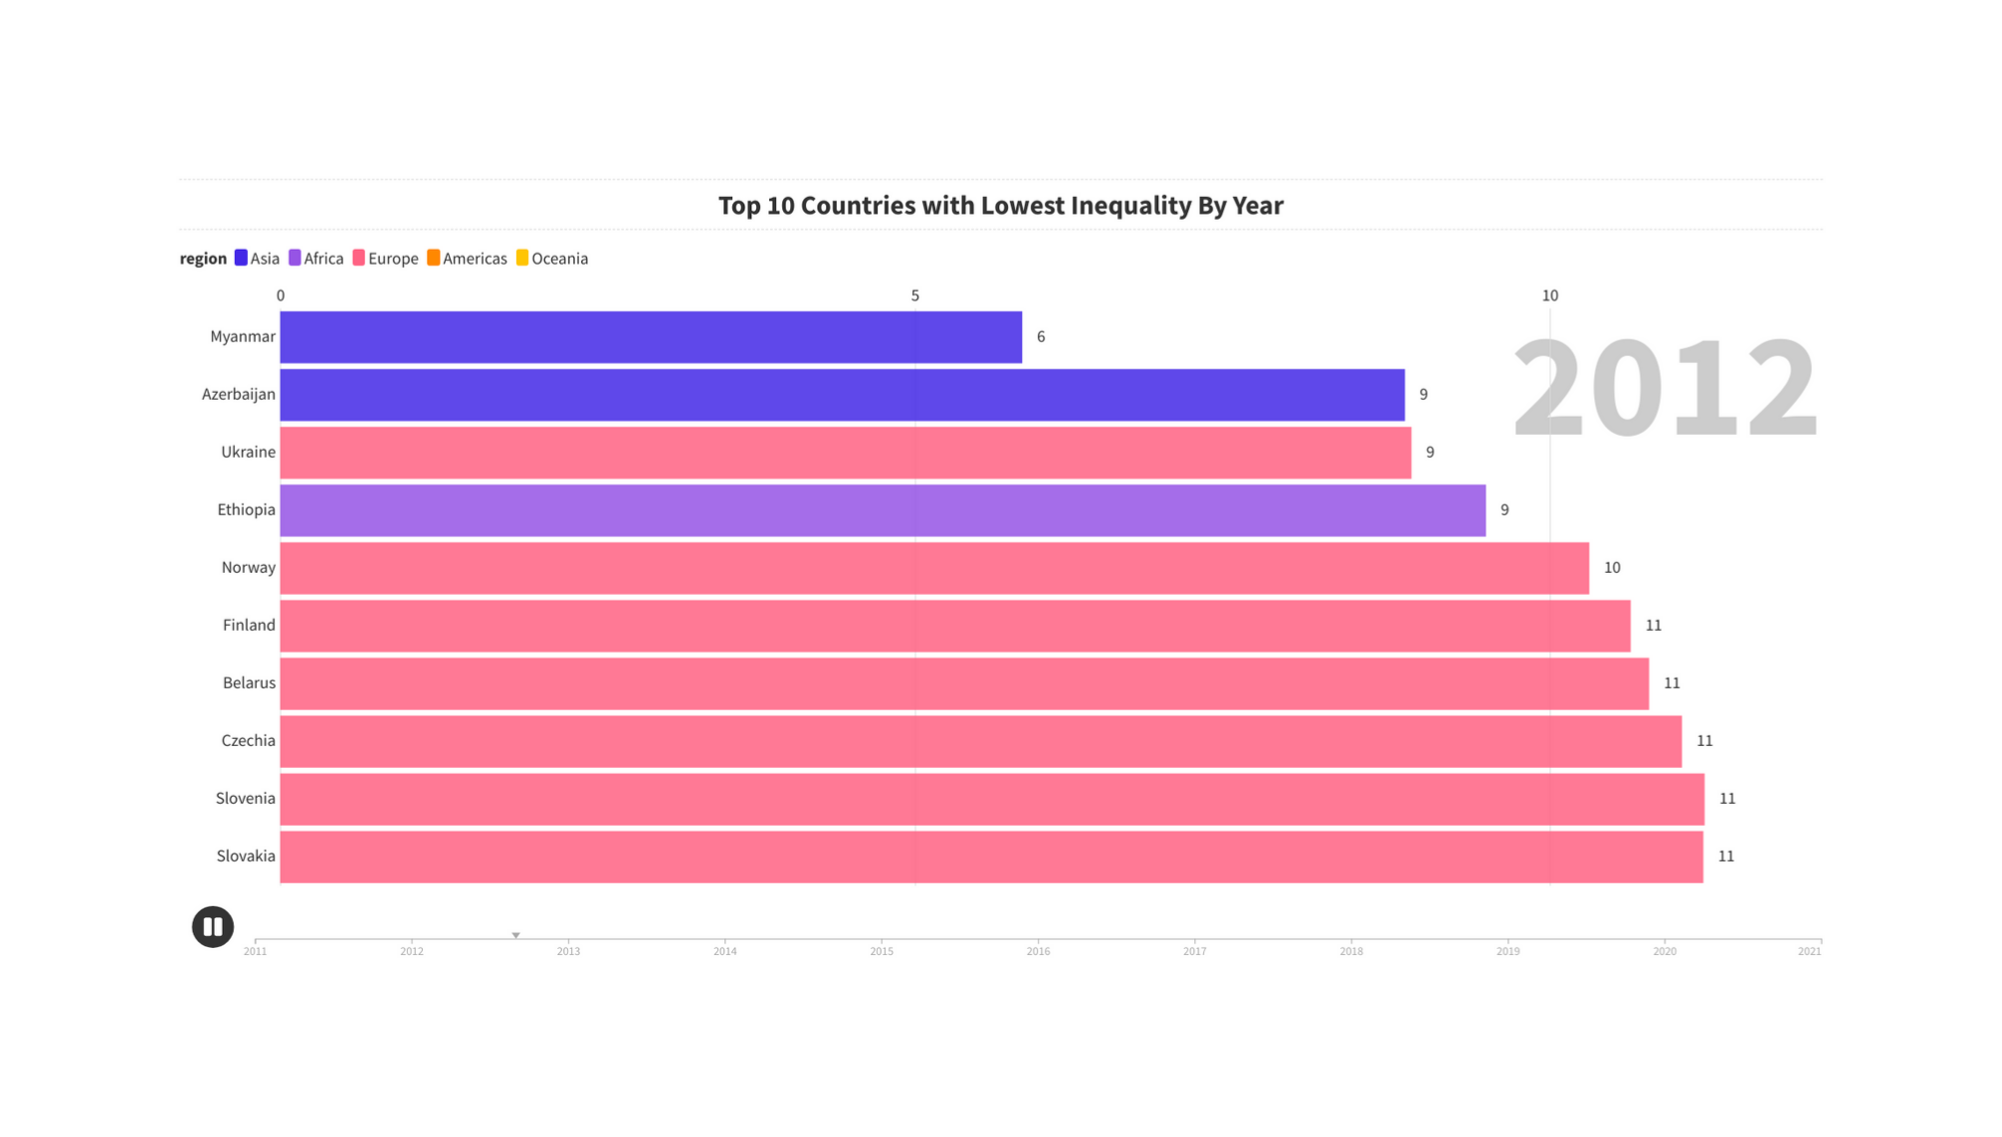
Europe has dominated the top 10 positions with 8 countries since 2017.
No country from Oceania or the Americas has made it to the top 10.
Africa had only one country in the top 10 until 2016, with none afterward.
Ukraine has consistently secured a top 3 position throughout the years.
Czechia has shown continuous growth, moving from the 10th position in 2011 to the 3rd in 2021.

Slide 10
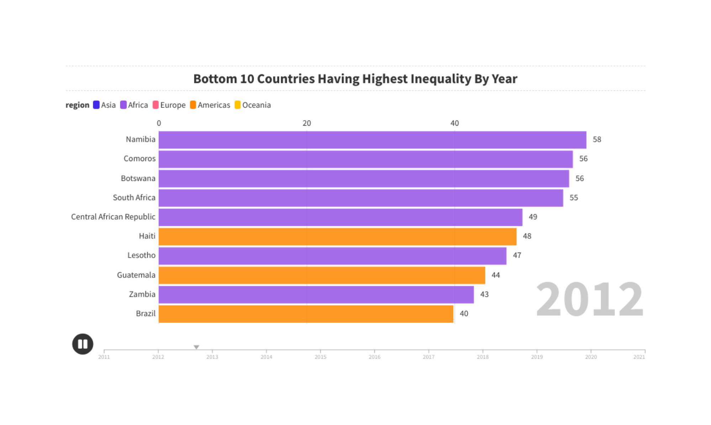
South Africa and Comoros have consistently ranked as the most unequal countries since 2015.
The Bottom 10 includes only countries from Africa and America.

Slide 11
The Relationship b/w Income Inequality and Other Socioeconomic Metrics

Slide 12
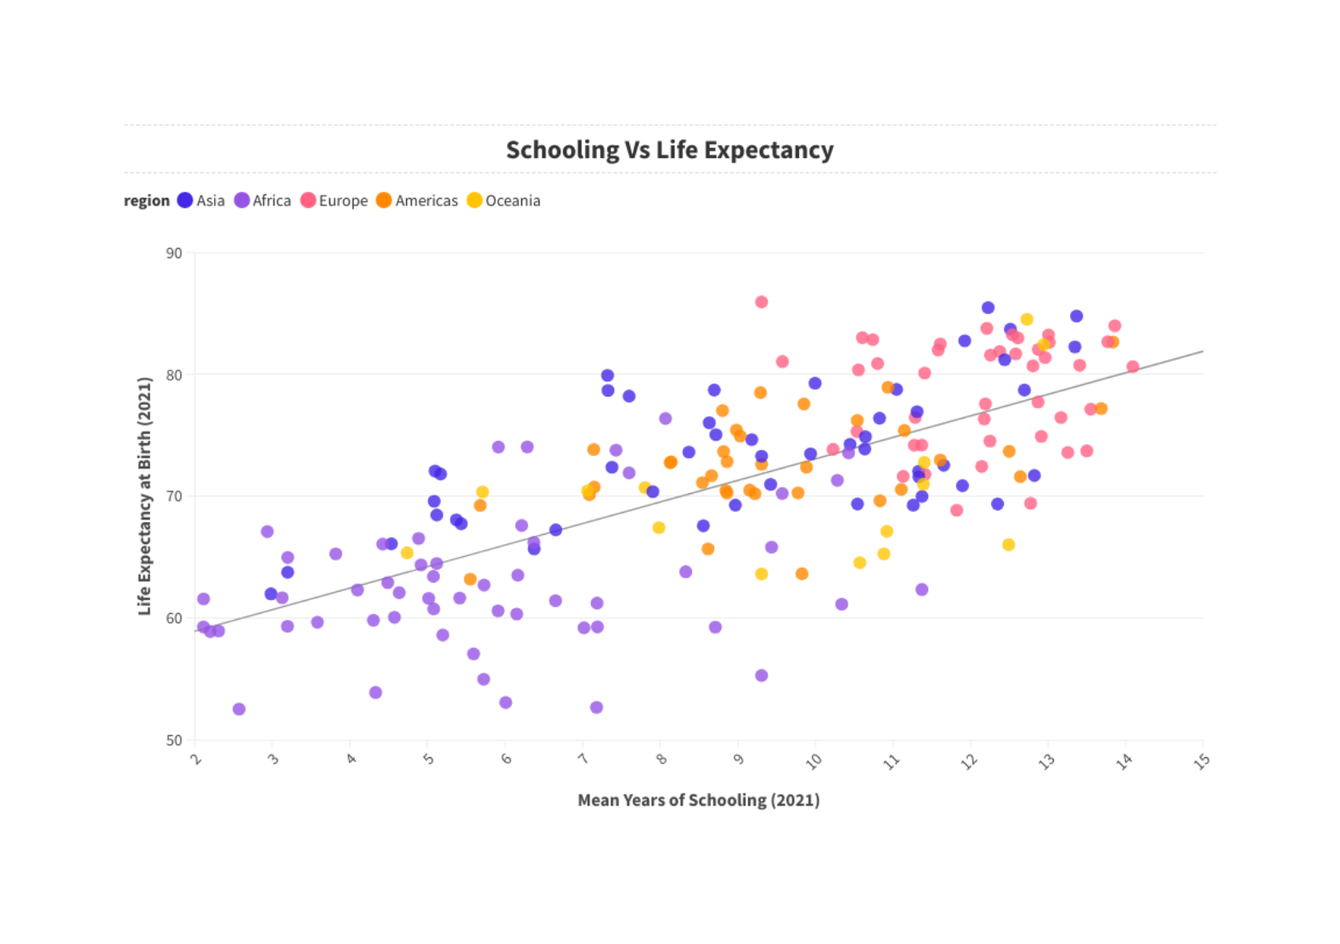
Years of schooling and life expectancy are positively correlated, indicating they tend to increase together.
Countries in the highest quartile (with the least inequality) generally exhibit higher levels of schooling and life expectancy.

Slide 13
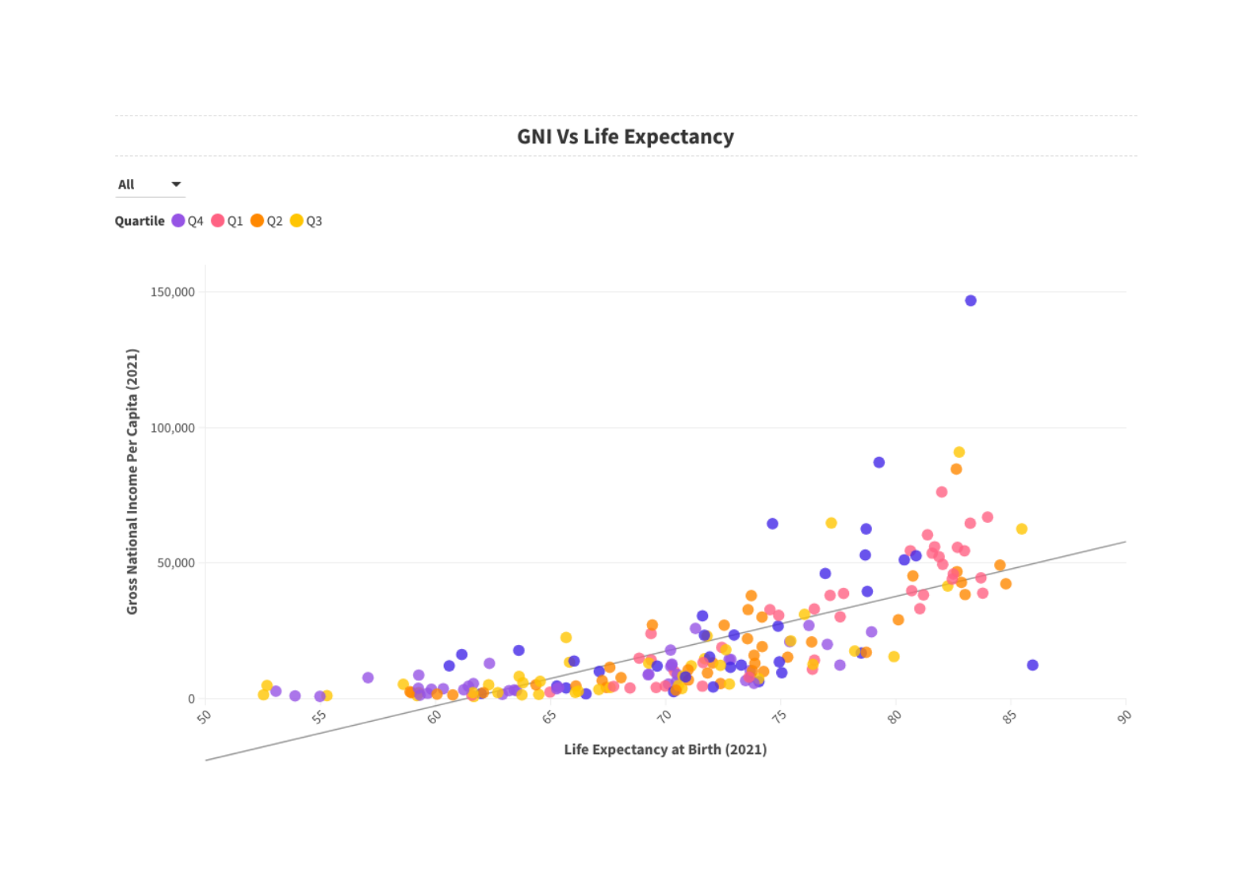
There is a positive relationship between GNI and Life Expectancy .
There is no clear pattern between inequality quartile across the interaction of GNI and Life Expectancy.

Slide 14
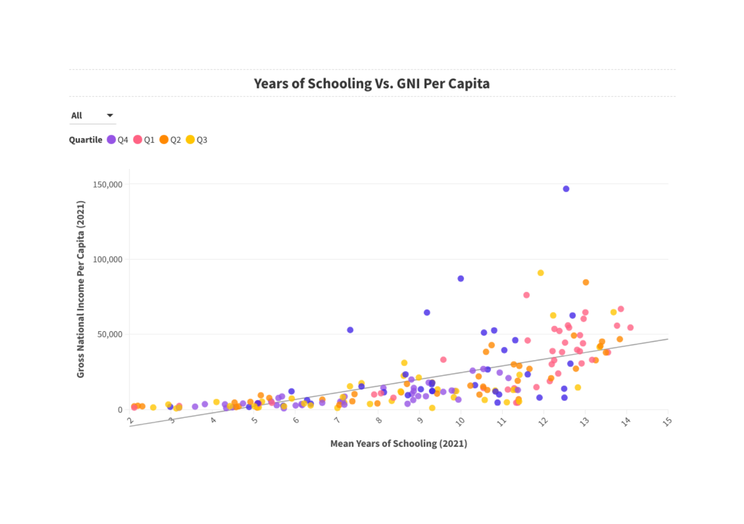
There is a positive relationship between GNI and Life Expectancy .
There is no clear pattern between inequality quartile across the interaction of GNI and Life Expectancy.

Slide 15
Region Wise Analysis of All Socioeconomic Metrics

Slide 16
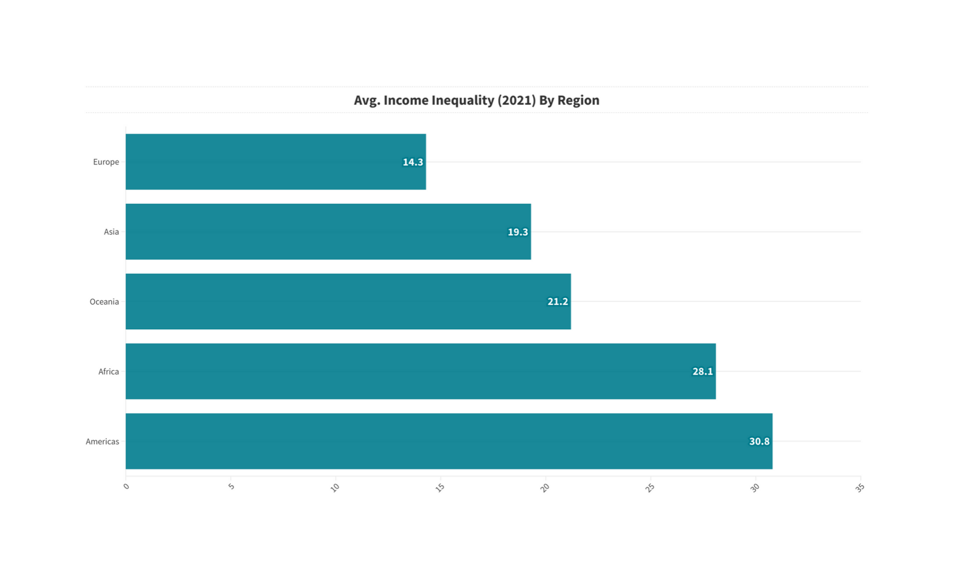
Europe exhibits the lowest income inequality with a Gini coefficient of 14.3, reflecting its effective social welfare and progressive taxation systems that contribute to a more equitable income distribution.
The Americas have a Gini coefficient of 30.8, indicating a notable level of income inequality, which is reflective of the diverse economic statuses across the continent, from highly developed economies to emerging markets.

Slide 17
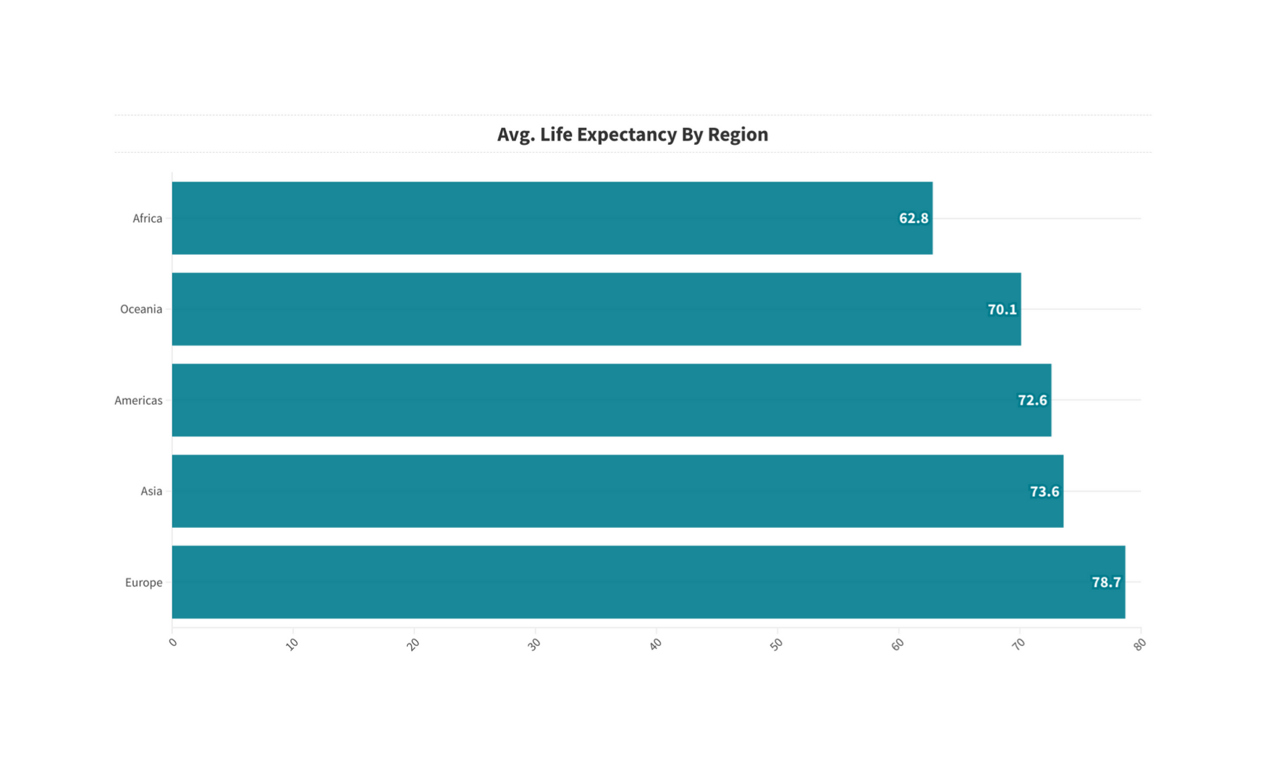
Regional Differences: The nearly 16-year gap between Africa and Europe highlights significant disparities in health outcomes, which could be attributed to factors such as economic development, healthcare access, disease burden, and social determinants of health.

Slide 18
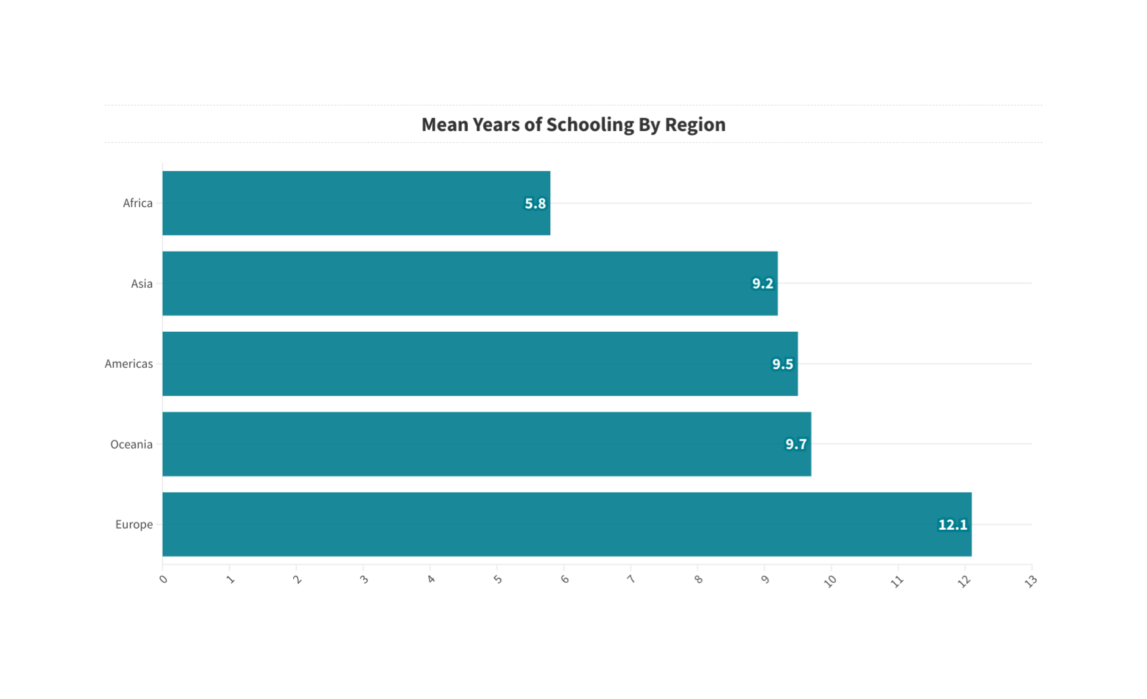
Europe leads with an average of 12.1 years of schooling, reflecting its strong educational systems
Africa has the lowest mean years of schooling at 5.8 years, which could reflect challenges such as limited access to education, economic barriers, and social issues.

Slide 19
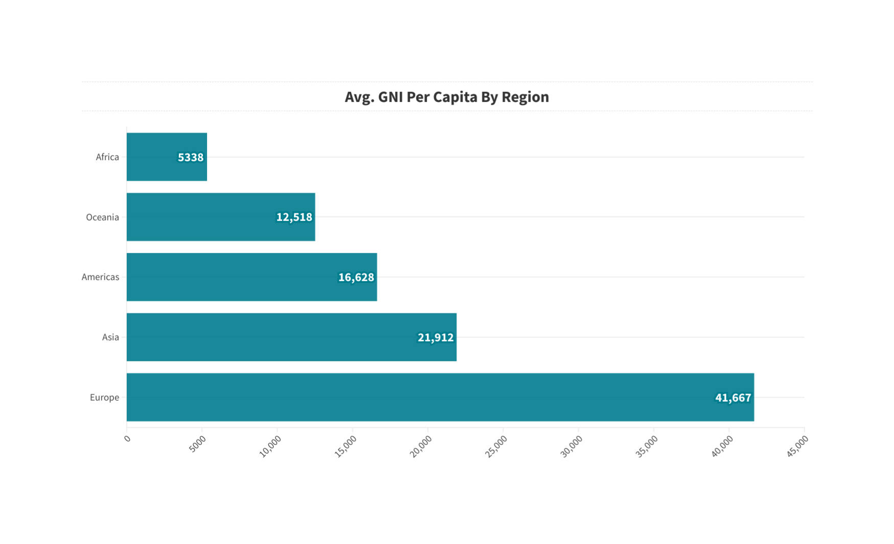
There’s a significant disparity in GNI per capita among the continents. Europe leads with a GNI per capita of $41,667, which is nearly 8 times higher than Africa’s, which has the lowest at $5,338.
Economic Development: The GNI per capita is often used as an indicator of economic development. Based on these figures, Europe and Asia appear to be more economically developed compared to other regions.

Slide 20


THANK YOU

